Slide 1

Project: Languru
SPRING 2023 - CS691 CAPSTONE PROJECT PROFESSOR HENRY WONG
PACE UNIVERSITY
Team 5 - RADIANT
Thanh Pham
Musa Nishat
Noel Sam Routhu
Indeevara Tadikonda
Hariharammurthy Krishnamoorthy

Slide 2
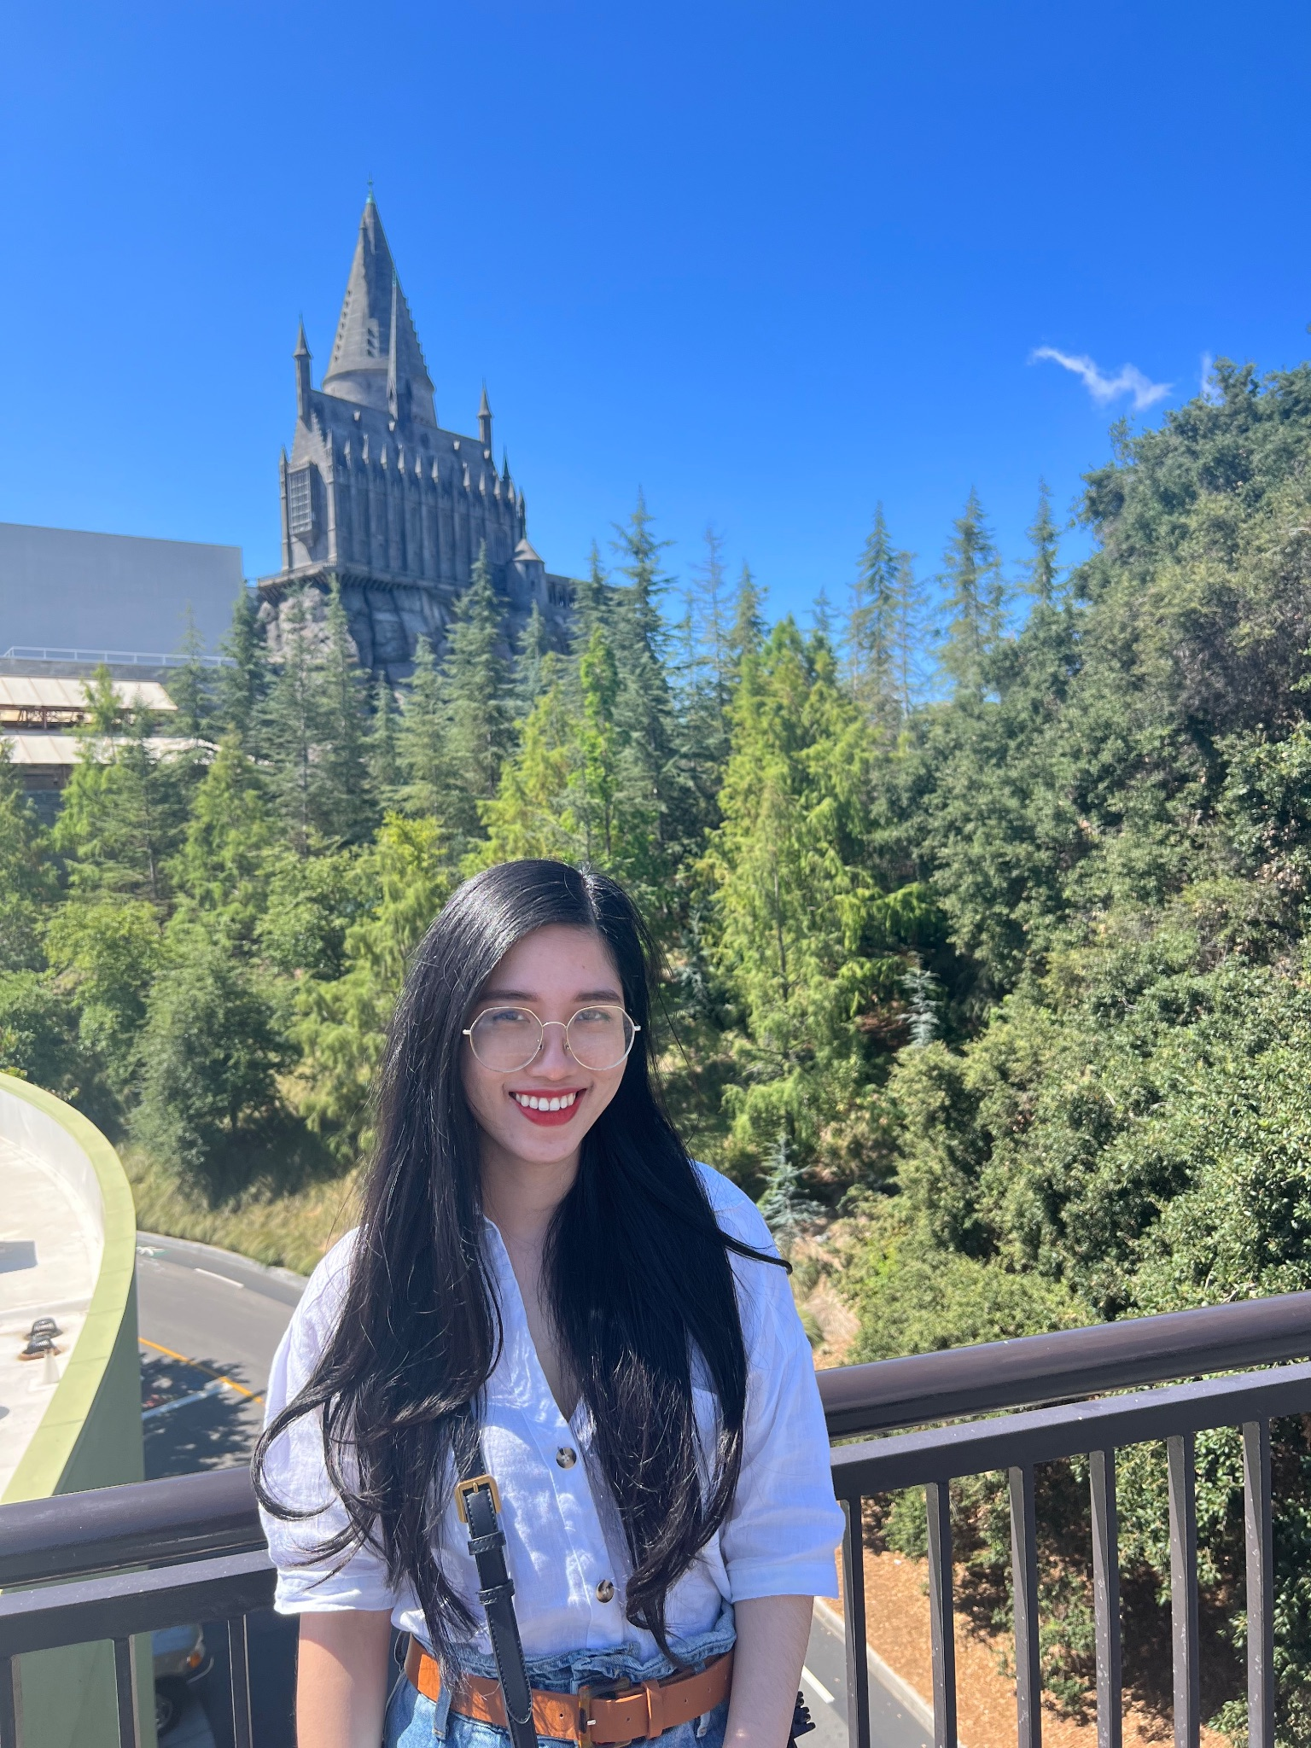
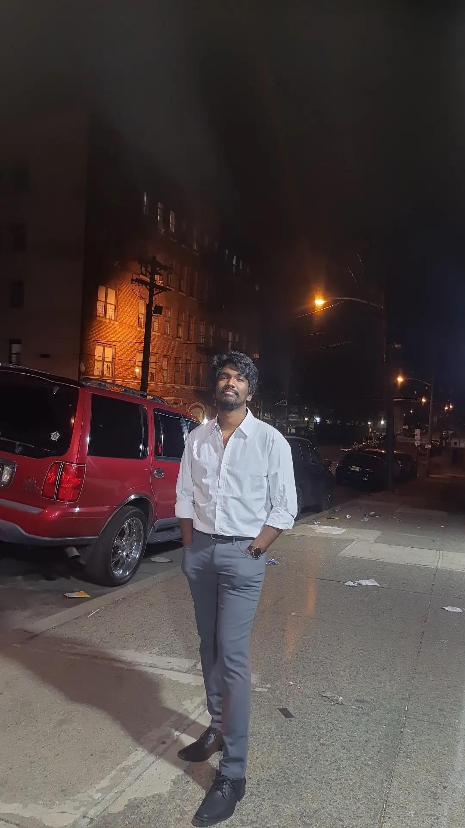
Team Member Roles
Thanh Pham
(Developer)
Noel Sam Routhu
(Database Administrator)

Slide 3


Team Member Roles
Musa Nishat
(Developer)
Indeevara Tadikonda
(Developer)

Slide 4

Team Member Roles
Hariharammurthy Krishnamoorthy
(Quality Analyst And Tester)

Slide 5
Team Members Roles
Name | Roles
Thanh Pham | Developer, Project Manager
Musa Nishat | Developer
Noel Sam Routhu | Database Administrator
Indeevara Tadikonda | Developer
Hariharammurthy Krishnamoorthy | Quality Analyst And Tester

Slide 6
Agenda
01
Problem Statement
05
Languages and Tools
02
Project Description
06
Schedule and Sprint
03
Market Analysis
07
Team Working Agreement
04
Personas
08
Retrospective

Slide 7
Problem Statement
English learners faces challenges when they speak E.L correctly due to limited feedback on their speech while English teachers’ feedback is costly and time consuming.
The current speech recognition technology is not accurate enough to provide reliable feedback on pronunciation, which can hinder the learning process.

Slide 8
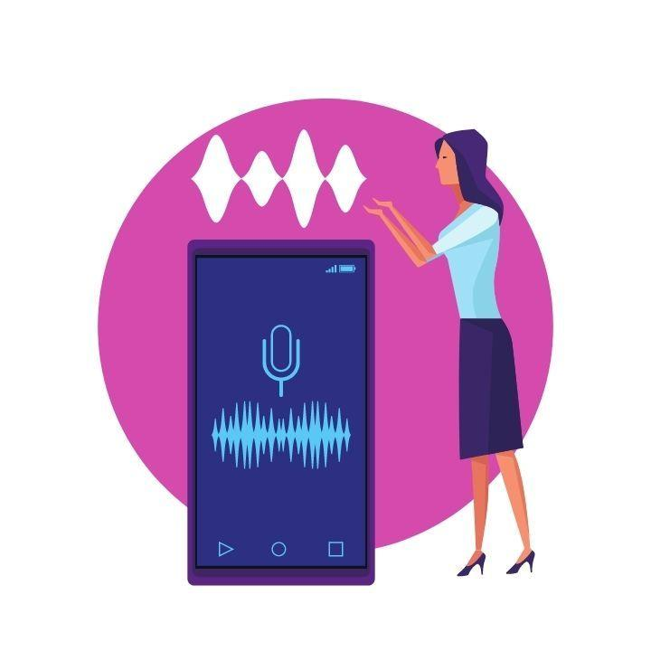
Project Description
Languru is a cutting-edge web application that brings together the best of language and guru to help English learners improve their pronunciation and fluency. Using advanced voice recognition technology, Languru allows users to record their voice and receive real-time feedback on their pronunciation accuracy. Languru is capable of breaking down the sound of a word to check individual components, and uses voice recognition algorithms to identify which parts of the word are pronounced correctly or incorrectly. With machine learning, the accuracy of the feedback can be continually improved, making this software an indispensable tool for anyone looking to improve their English speaking skills.

Slide 9
Market Analysis
The main focus of Languru is on customers / vendors who strive to learn/speak/teach English language on regular basis.
According to "Research and Market's" analysis - 'The global English Language Learning Market is expected to reach $69.62 billion by 2029, at a CAGR of 9.5% during the forecast period of 2022-2029'
Based on geography, the market is segmented into North America, Europe, Asia-Pacific, Latin America, and Middle East and Africa. In 2023, Asia-Pacific is expected to account for the largest share of the global English language learning market and is expected to grow at the highest CAGR during the forecast period.
Vendor Outreach:
The key players operating in the global English language learning market are Cambridge University Press (U.K.), New Oriental Education & Technology Group Inc. (China), Houghton Mifflin Harcourt Company (U.S.), McGraw-Hill Education, Inc. (U.S.), Duolingo Inc. (U.S.), Berlitz Corporation (U.S.), Busuu Online S.L. (Spain), Babble GMBH (Germany), Linguistica 360, Inc. (U.S.), Mondly (Romania), ELSA Corp. (U.S.), FluentU (A part of Enux Education Limited) (China), Memrise Inc. (U.K.), Mango Languages (U.S.), Rosetta Stone Ltd. (A part of IXL Learning, Inc.) (U.S.), Inlingua International Ltd. (Switzerland), Sanako Corporation (Finland), Transparent Language, Inc. (U.S.), and Open Education LLC (U.S.).

Slide 10
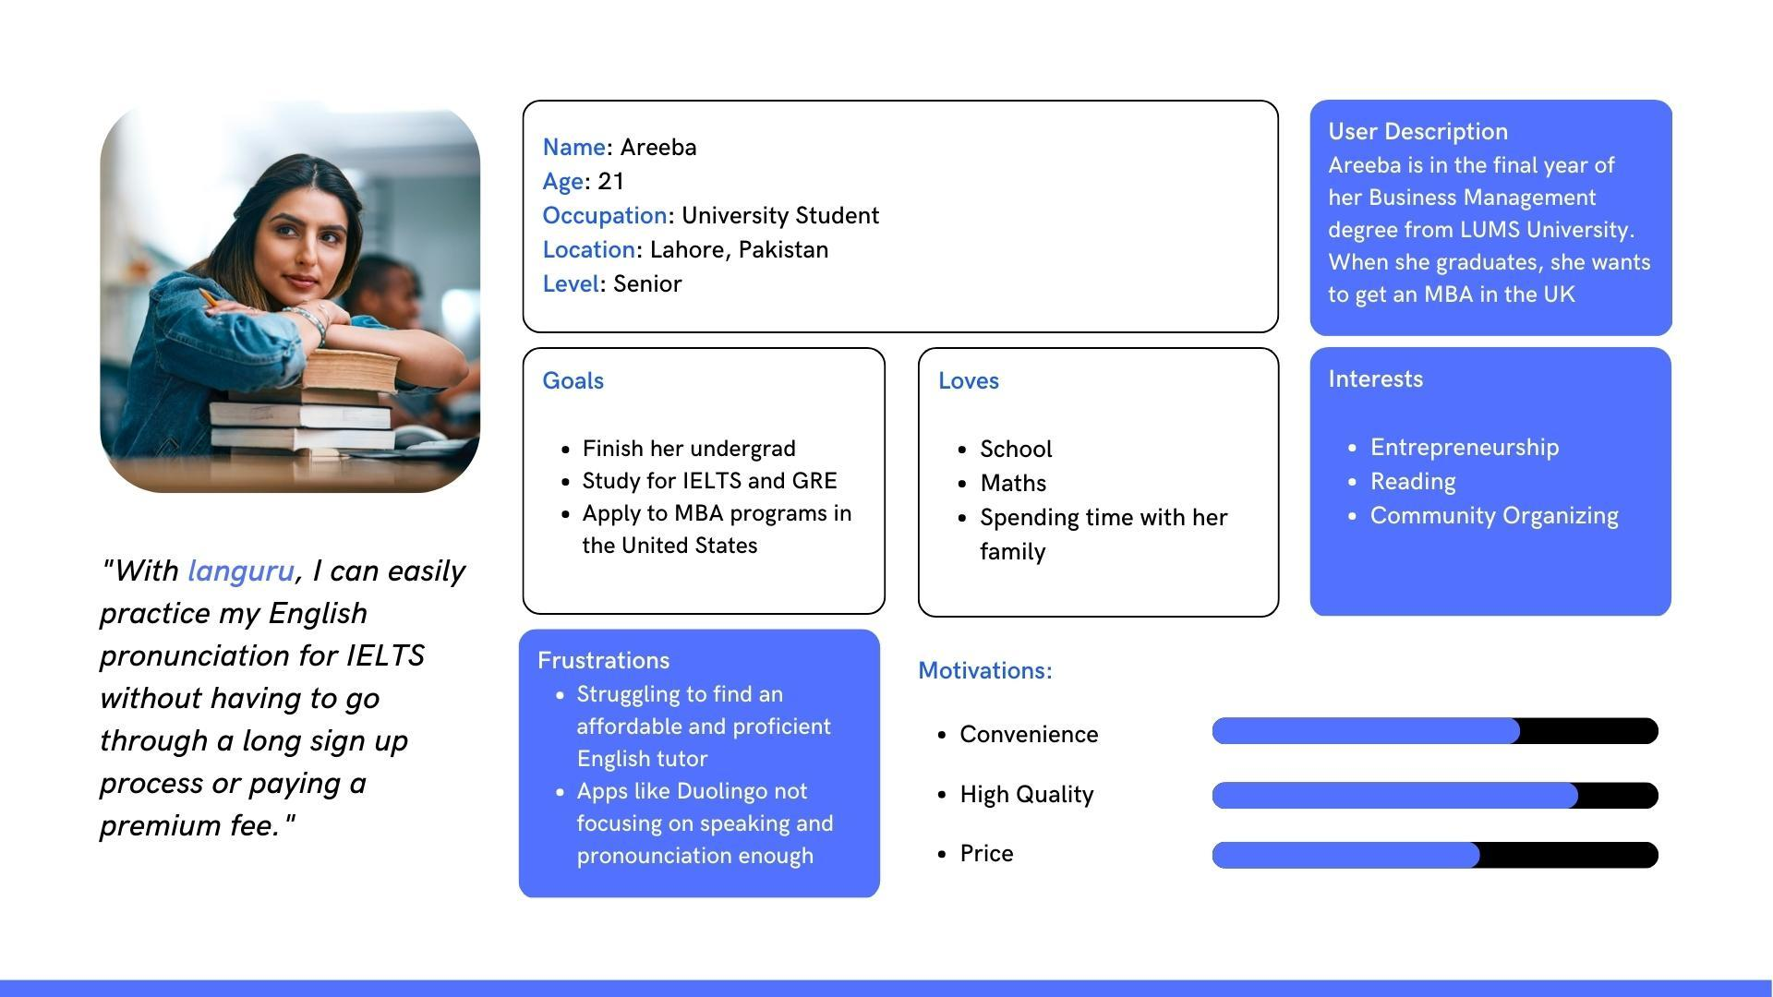
Personas

Slide 11
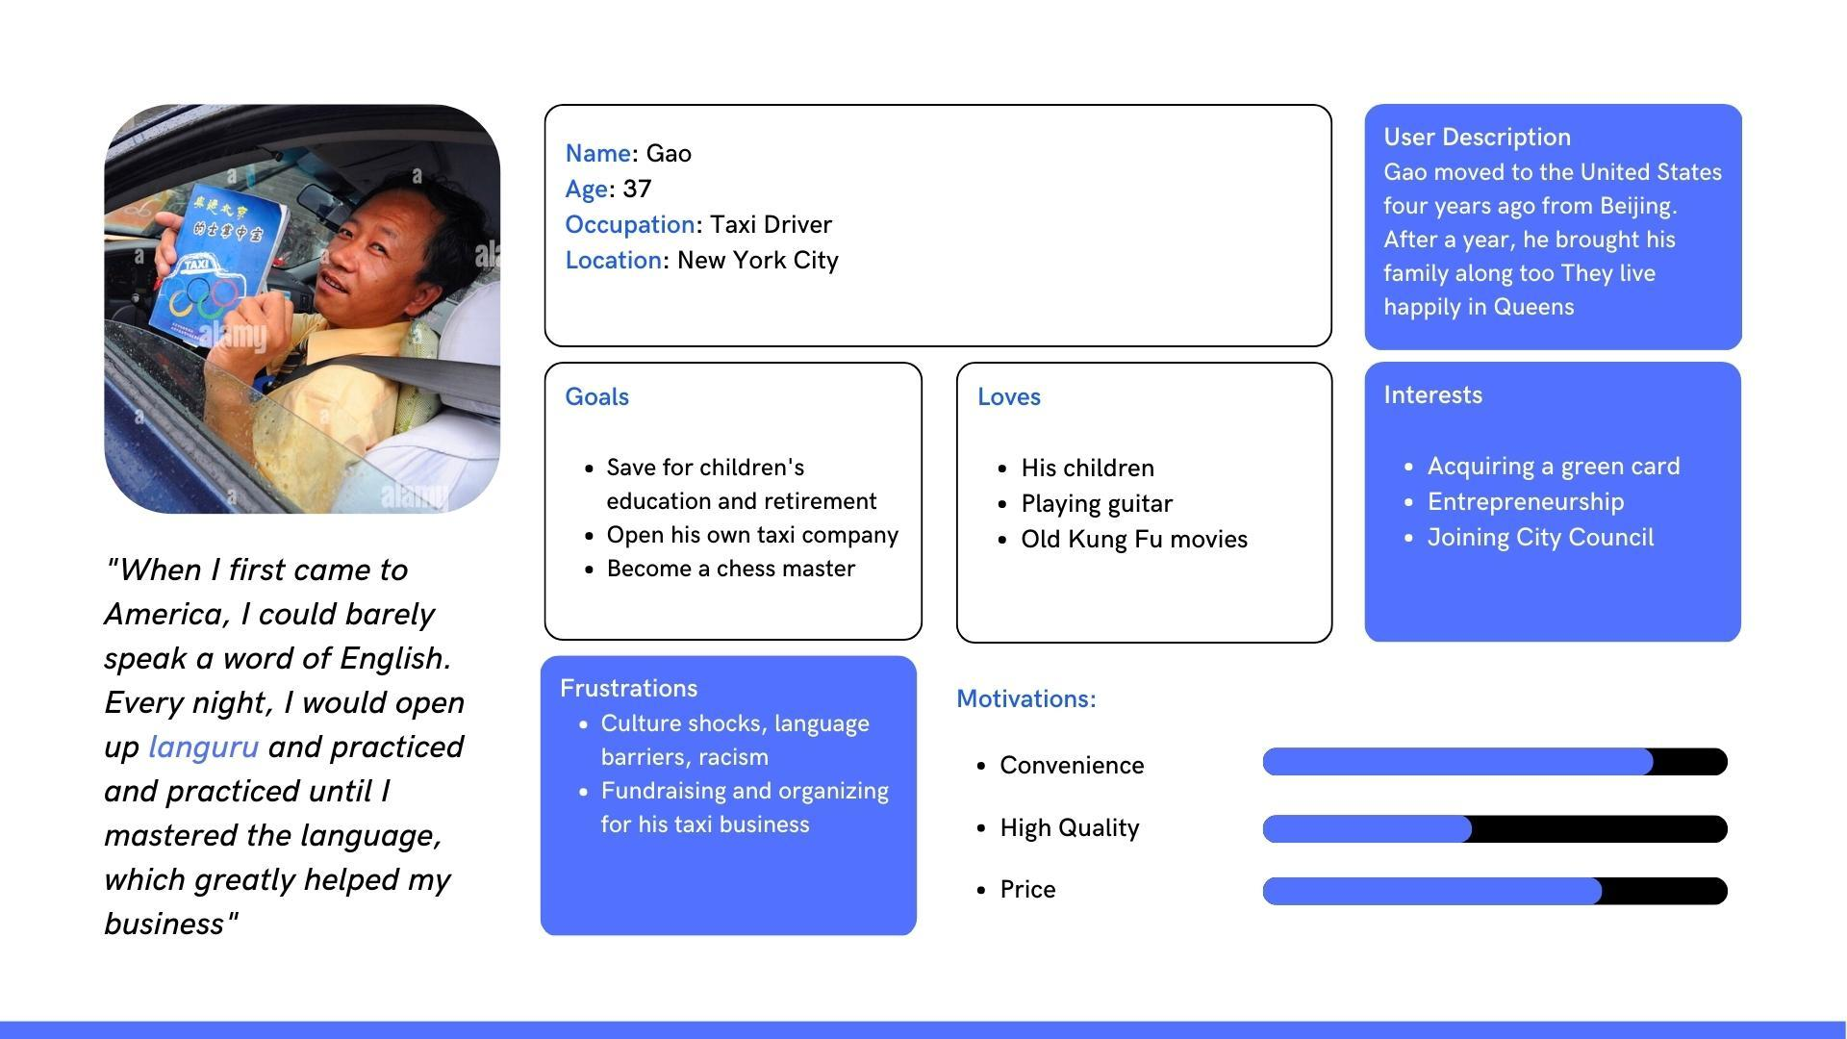
Personas

Slide 12
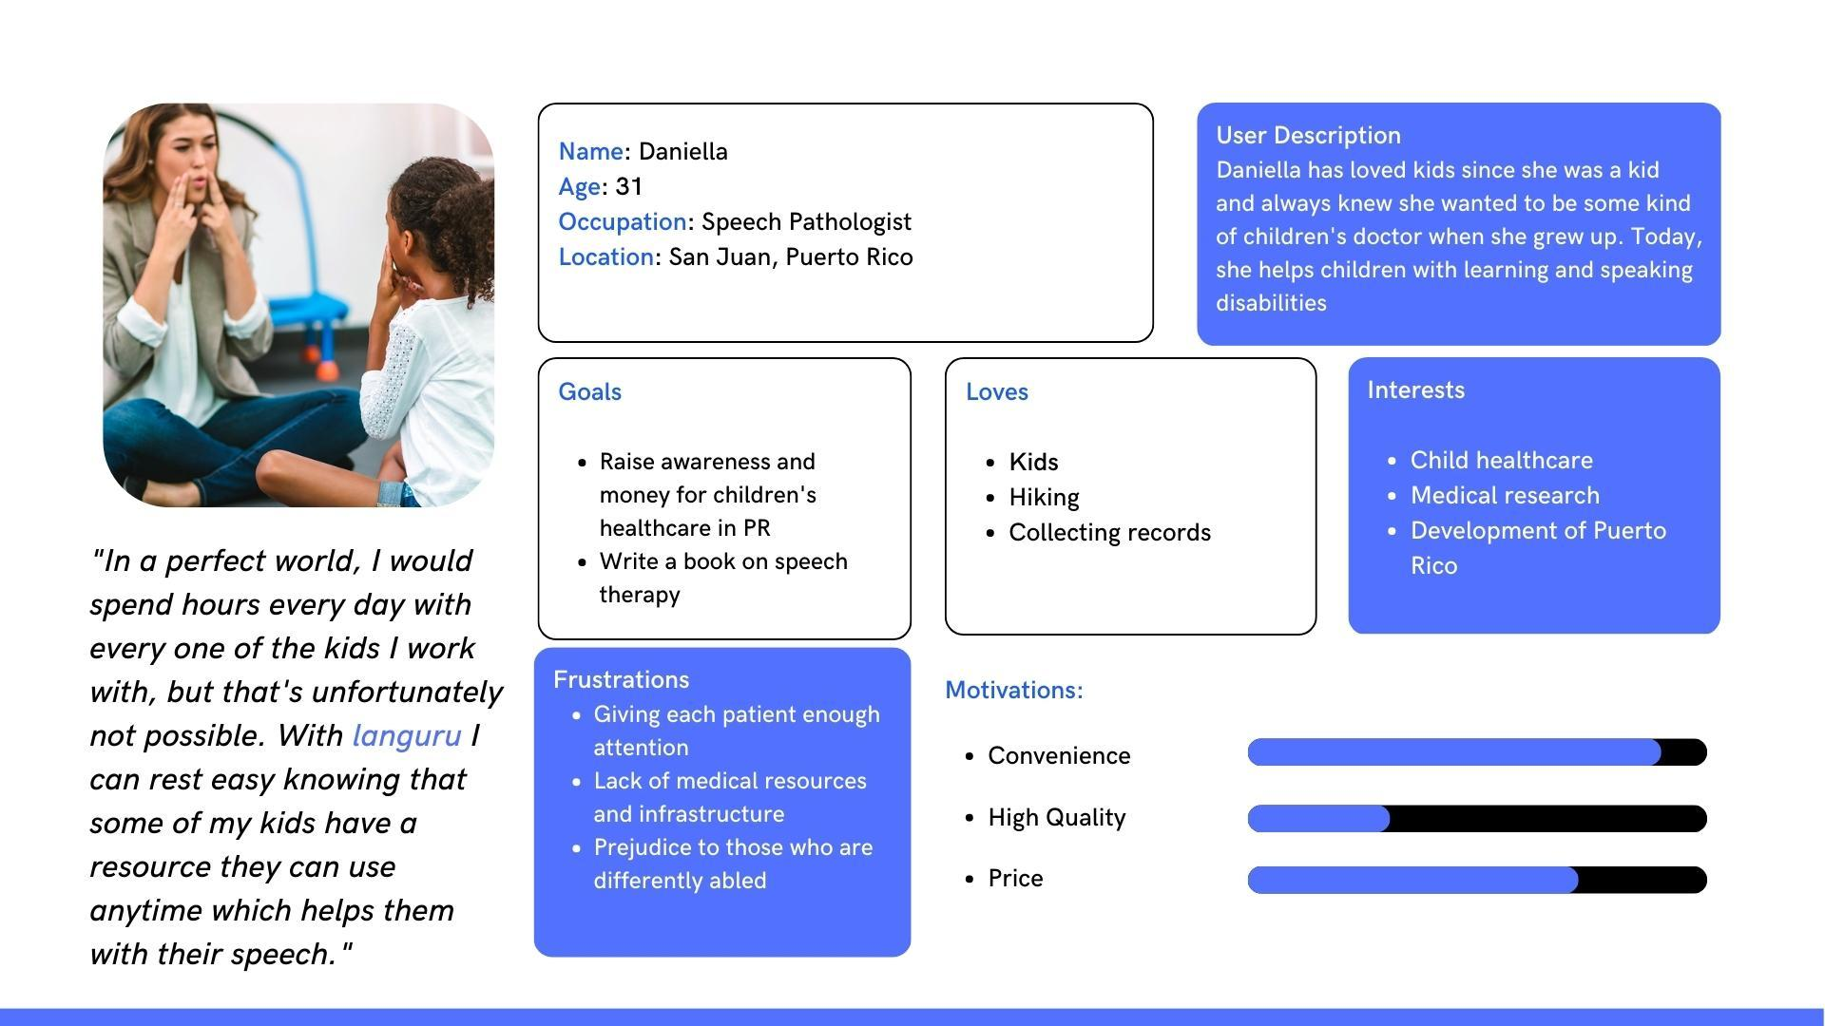
Personas

Slide 13
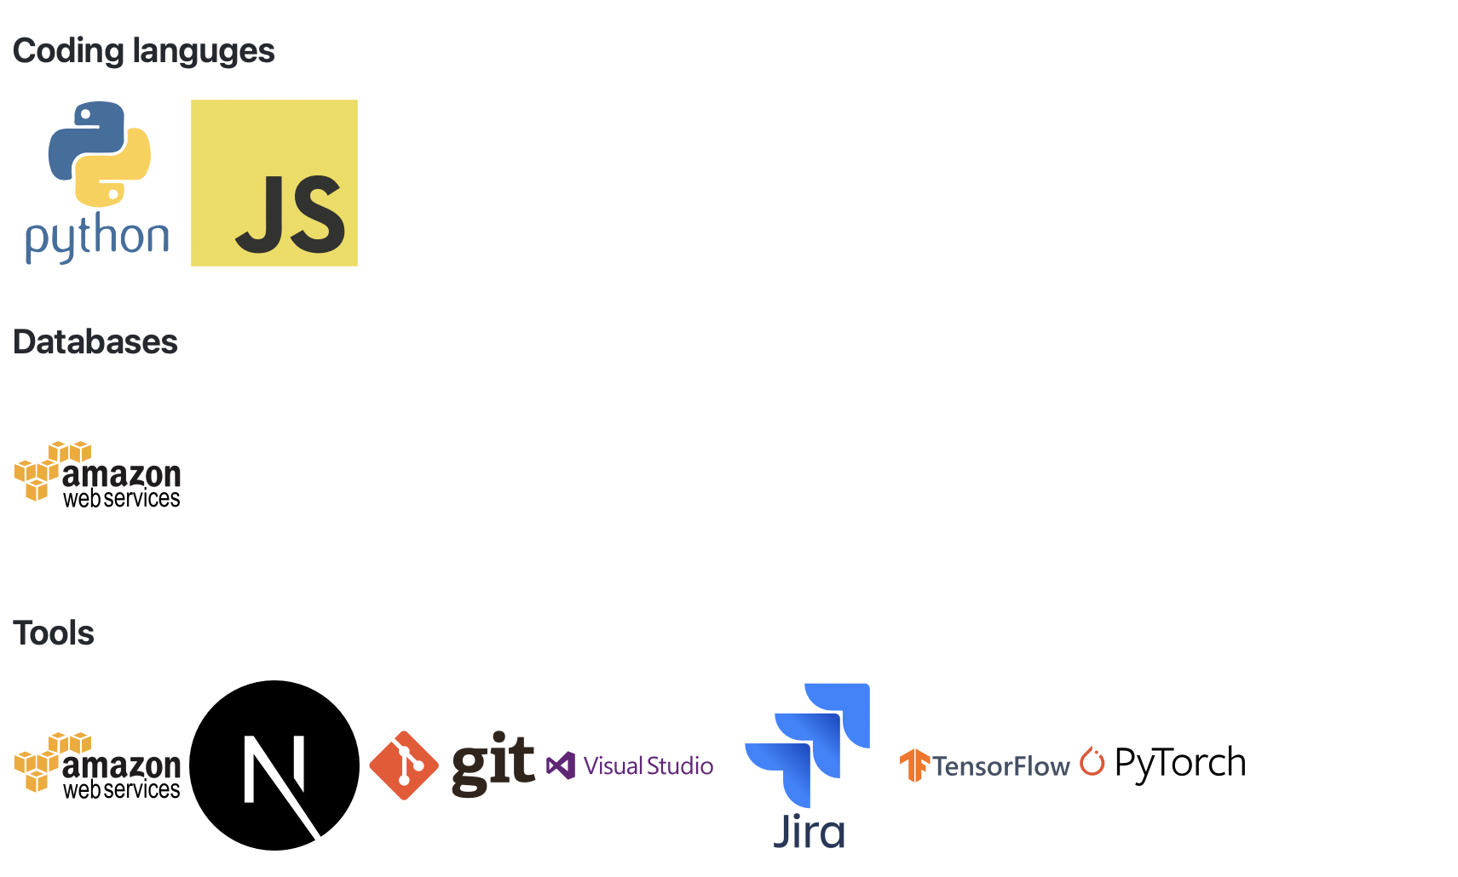
Languages and Tools

Slide 14
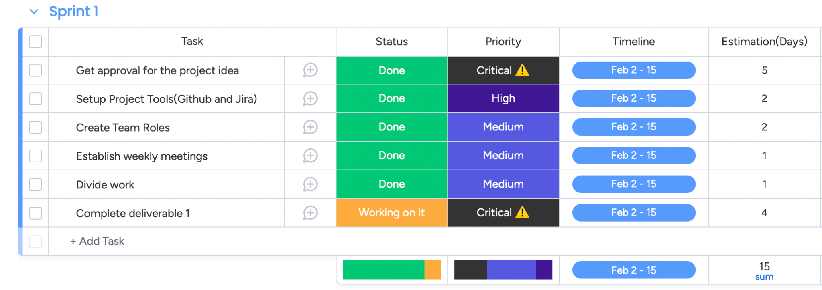
Schedule + Sprint

Slide 15
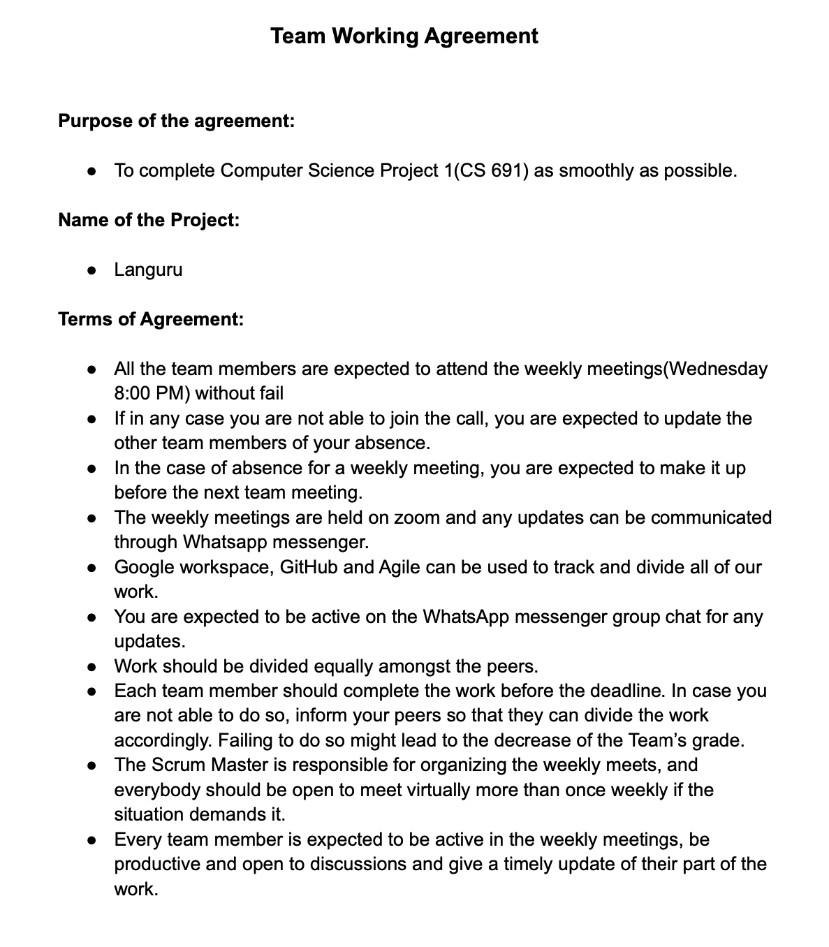
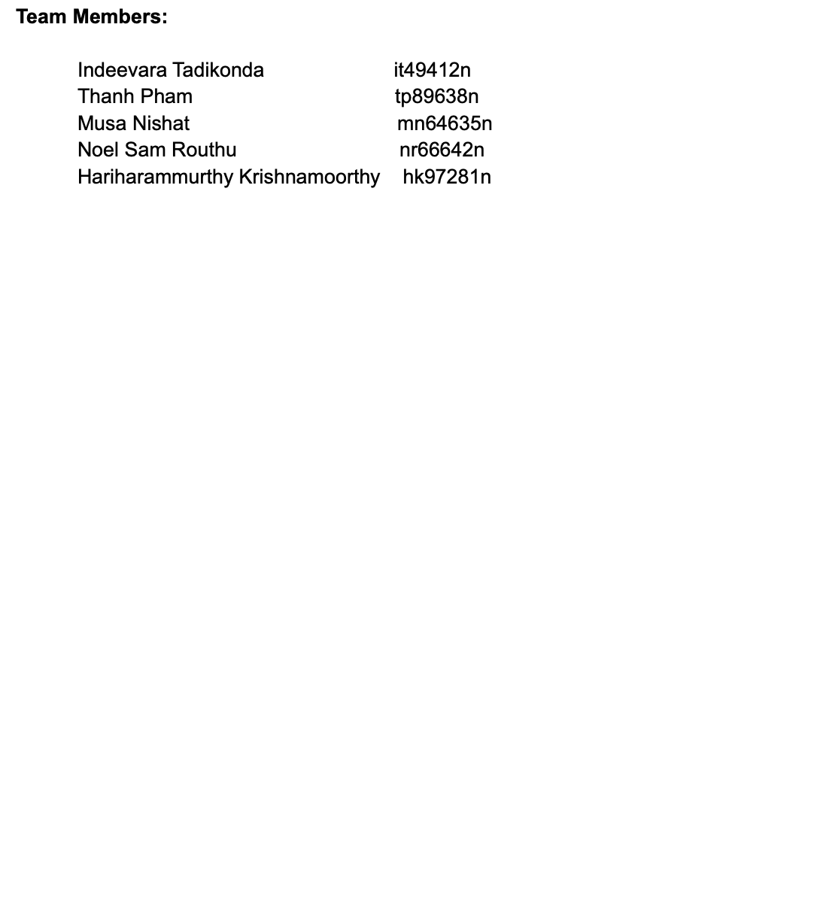
Team Working Agreement

Slide 16
Retrospective
Open Communication: The team members had open communication, which facilitated the exchange of ideas, opinions, and feedback. The team encouraged collaboration, which ensured that everyone was on the same page and working towards the same objectives.
Well-Defined Roles and Responsibilities: The team had well-defined roles and responsibilities, which ensured that everyone knew what was expected of them. This clarity helped the team to work efficiently and effectively, as everyone knew what they needed to do to achieve the project's objectives.
What Went
Well
Agile Methodology: The team's adoption of an Agile methodology was a strength, as it allowed the team to be responsive to changes and adapt to new requirements quickly. The approach enabled the team to work in sprints and focus on prioritized tasks, which resulted in an efficient and effective development process.

Slide 17
What Needs Improvement?
Better Time Management: The team could improve their time management skills by setting more realistic goals and deadlines. The team could also prioritize tasks and set achievable milestones to ensure that they deliver quality work within the given timeframe.
Enhanced Documentation: The team could improve their documentation practices by ensuring that project-related information is accurately documented and easily accessible. This includes project plans, meeting minutes, progress reports, and technical documentation.
Continuous Learning: The team could focus on continuous learning and skill-building to keep up with the latest technology and development trends. The team could also consider incorporating training and development opportunities into the project plan to help team members learn new skills and technologies.

Slide 18
Goals For Next sprint:
Improve our testing practices, including using automated testing and through manual testing to ensure the application is working correctly
Improve our communication by having more focused meetings, reducing unnecessary emails, and using collaboration tools to communicate in real-time.
Enhance our collaboration by sharing knowledge and resources, seeking feedback, and supporting each other. We will also aim to create a positive and inclusive work environment to promote creativity and innovation.

Slide 19
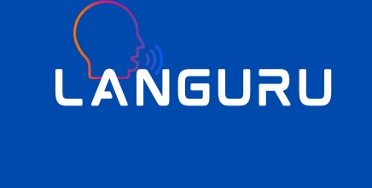
Group Wiki page Link:
https://github.com/htmw/Languru/wiki

Slide 20
Thank you for your listening!

